Slide 1
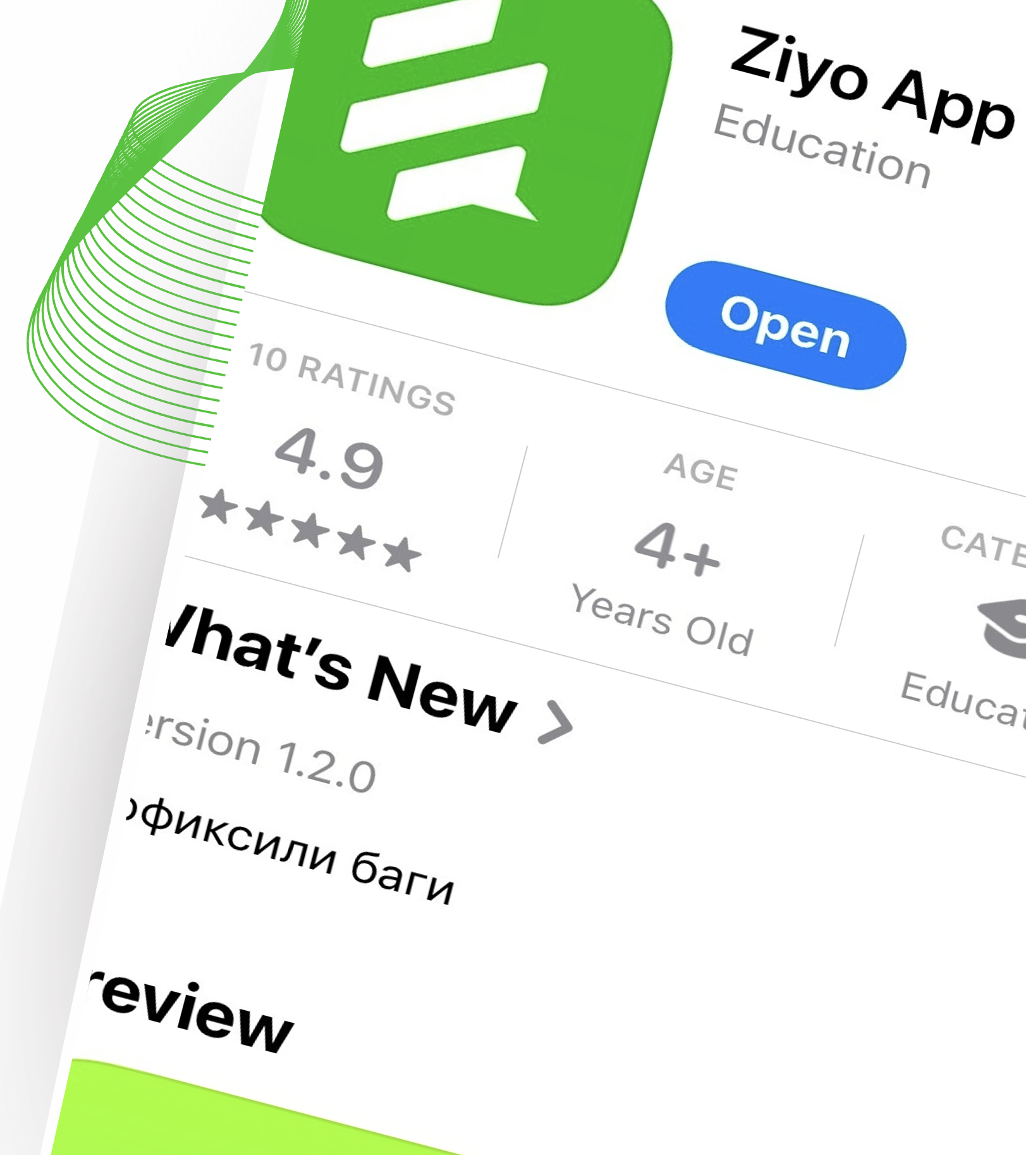
Ziyo App
Content, Growth and Partner Strategy
Stefanie, Anja, Pankaj – SAP SE
October 14, 2026

Slide 2

Welcome!
Xush kelibsiz!

Slide 3
Content Strategy
EVENTS
CURATED CONTENT
PARTNERSHIPS
Regular Events
News (e.g. Arlod Media)
Active vs. Non-Active Partners
One-Off Events
Scholarships & Grants
Ambassadors
"Ziyo Cup" Fun Events
Internship Listings
Cross-Funding from Partners?
Podcast
Research Opportunities
Video
Anything Else
Content Sourcing: identify Uzbek-specific needs (e.g. Cybersecurity, STEM, Language)
Ziyo App · Product Vision Workshop · October 2026 · Content Strategy

Slide 4
Info Needed
Usage / View Statistics
List of Events
List of Media Assets
Ambassadors Info
Funding of Events & Media
Ziyo App · Product Vision Workshop · October 2026 · Info Needed

Slide 5
Ideas
Tiering for Partners
"Easy Way to Capture Content" (LD concept)
Visibility for Ambassadors + Feature Partner Orgs
Join Forces on Ziyo App / Rewards → Complete Student Portfolio
Alumni Support & Success Stories
Mentoring / Coaching / Peer-to-Peer Coaching
Ziyo App · Product Vision Workshop · October 2026 · Ideas

Slide 6
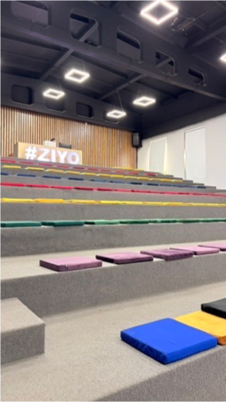
Common Ground Umumiy fikr

Slide 7
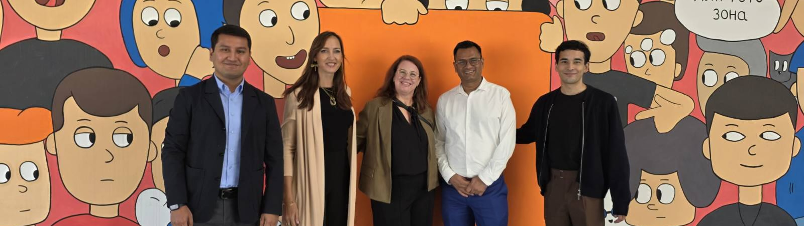
Thank you!
Thank you!
Спасибо
Rahmat

Slide 8
Name, SAP
Month Date, Year

Slide 9
Name, SAP
Month Date, Year

Slide 10
Name, SAP
Month Date, Year

Slide 11

Name, SAP
Month Date, Year

Slide 12
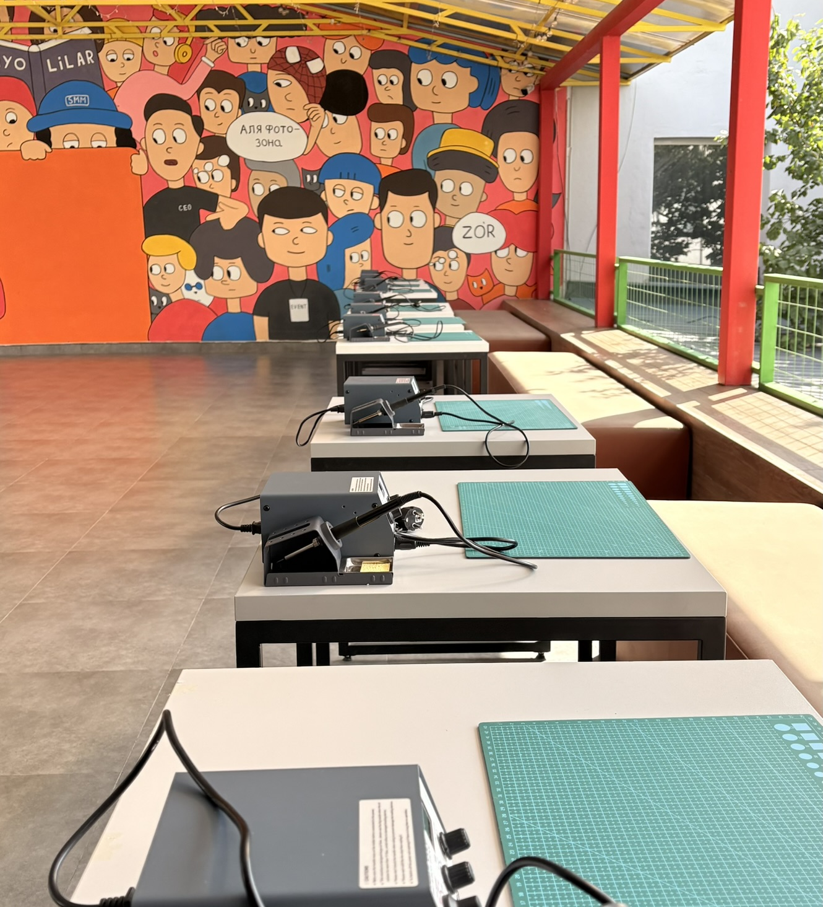
Name, SAP
Month Date, Year

Slide 13
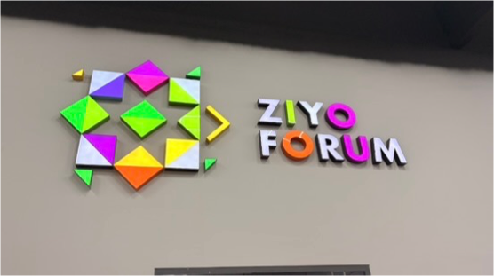
Name, SAP
Month Date, Year

Slide 14
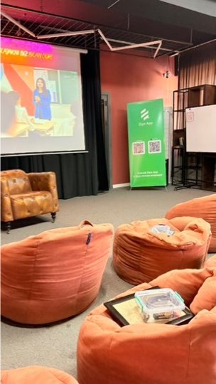
Name, SAP
Month Date, Year

Slide 15
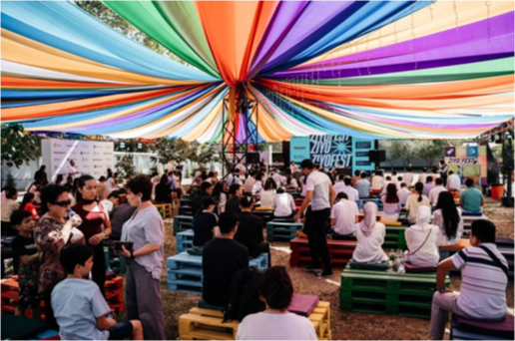
Name, SAP
Month Date, Year

Slide 16
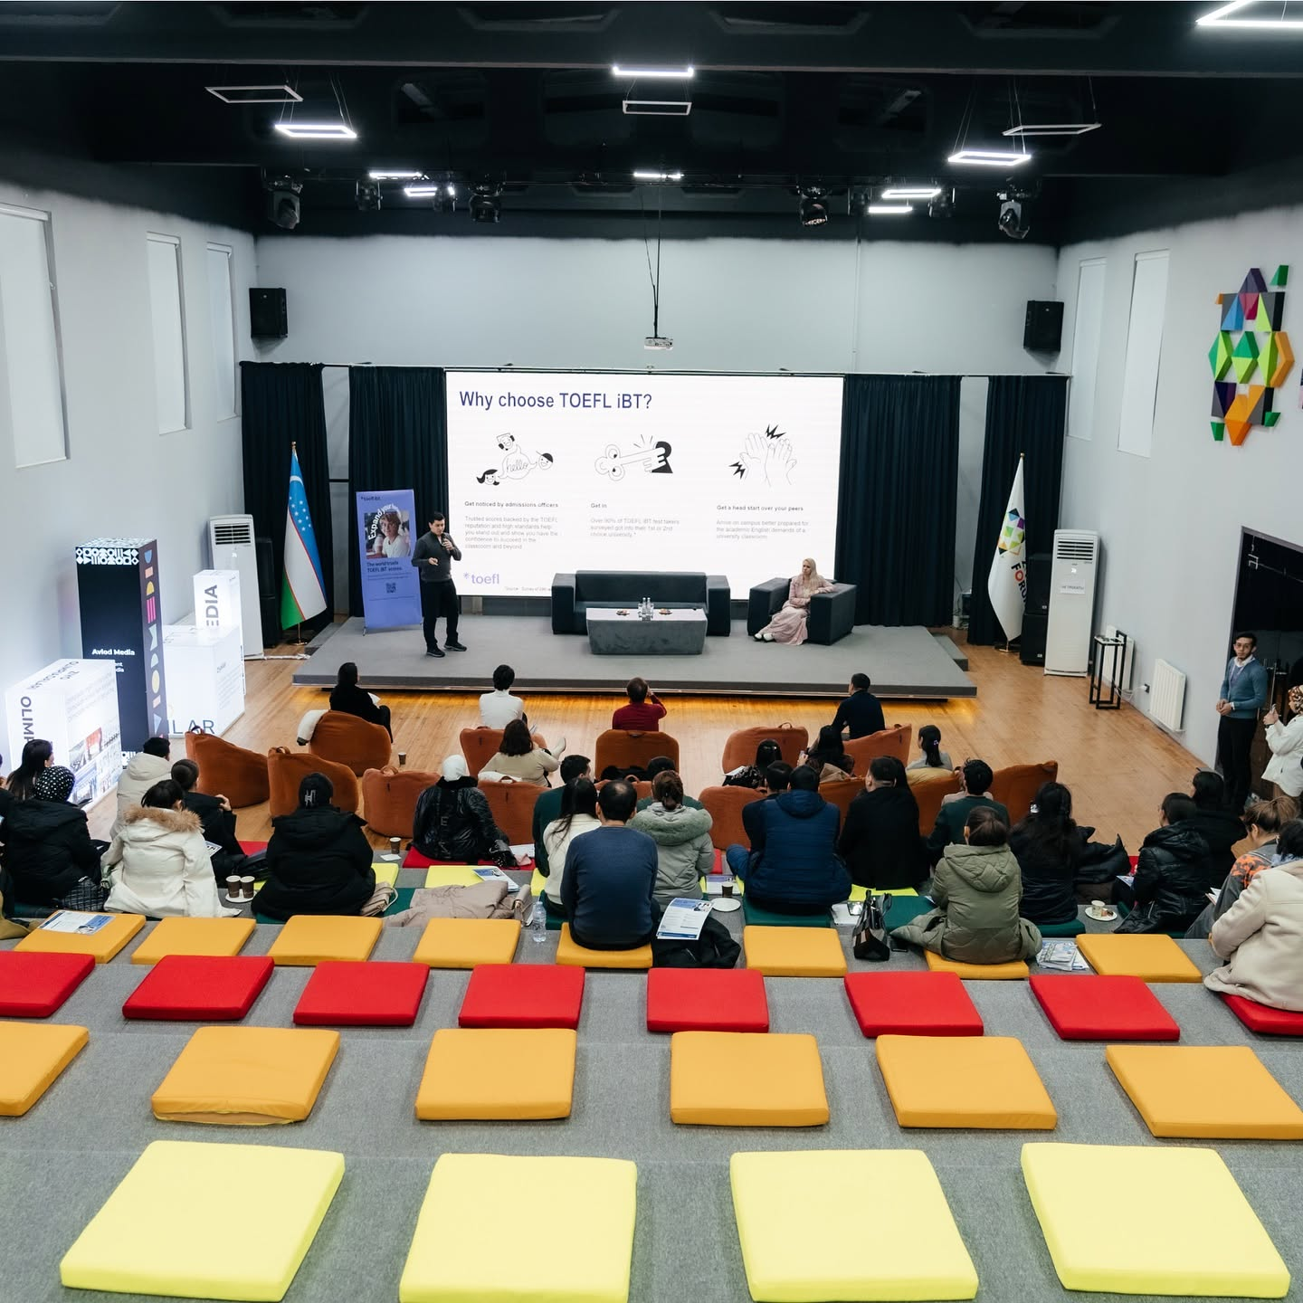
Name, SAP
Month Date, Year

Slide 17
Headline

Slide 18
Headline
Sub-Headline

Slide 19
Headline
Sub-Headline
Name, SAP
Month Date, Year

Slide 20
Agenda
01
Agenda Sample Text
Short description
02
Agenda Sample Text
Add a short description
03
Agenda Sample Text
Add a short description
04
Agenda Sample Text
Add a short description
05
Agenda Sample Text
Add a short description
05
Agenda Sample Text
Add a short description

Slide 21






Logos

